Slide 1

William Stallings Computer Organization and Architecture 10th Edition
Notes:
Lecture slides prepared for “Computer Organization and Architecture”, 10/e, by William Stallings, Chapter 10 “Computer Arithmetic”.

Slide 2
Chapter 9
Computer Arithmetic
Notes:
We begin our examination of the processor with an overview of the arithmetic and
logic unit (ALU). The chapter then focuses on the most complex aspect of the ALU,
computer arithmetic. The logic functions that are part of the ALU are described in
Chapter 12, and implementations of simple logic and arithmetic functions in digital
logic are described in Chapter 11.
Computer arithmetic is commonly performed on two very different types of
numbers: integer and floating point. In both cases, the representation chosen is a crucial
design issue and is treated first, followed by a discussion of arithmetic operations.
This chapter includes a number of examples, each of which is highlighted in a
shaded box.

Slide 3
Arithmetic & Logic Unit (ALU)
Part of the computer that actually performs arithmetic and logical operations on data
All of the other elements of the computer system are there mainly to bring data into the ALU for it to process and then to take the results back out
Based on the use of simple digital logic devices that can store binary digits and perform simple Boolean logic operations
Notes:
The ALU is that part of the computer that actually performs arithmetic and logical
operations on data. All of the other elements of the computer system—control unit,
registers, memory, I/O—are there mainly to bring data into the ALU for it to process
and then to take the results back out. We have, in a sense, reached the core or
essence of a computer when we consider the ALU.
An ALU and, indeed, all electronic components in the computer are based on
the use of simple digital logic devices that can store binary digits and perform simple
Boolean logic operations.

Slide 4
Arithmetic & Logic Unit (ALU)
ALU is interconnected with the rest of the processor. Operands for arithmetic and logic operations are presented to the ALU in registers, and the results of an operation are stored in registers.
These registers are temporary storage locations within the processor that are connected by signal paths to the ALU.
The ALU also set flags as the result of an operation. For example, an overflow flag is set to 1 if the result of a computation exceeds the length of the register into which it is to be stored.
The flag values are also stored in registers within the processor. The processor provides signals that control the operation of the ALU and the movement of the data into and out of the ALU.
Notes:
The ALU is that part of the computer that actually performs arithmetic and logical
operations on data. All of the other elements of the computer system—control unit,
registers, memory, I/O—are there mainly to bring data into the ALU for it to process
and then to take the results back out. We have, in a sense, reached the core or
essence of a computer when we consider the ALU.
An ALU and, indeed, all electronic components in the computer are based on
the use of simple digital logic devices that can store binary digits and perform simple
Boolean logic operations.

Slide 5
Notes:
Figure 10.1 indicates, in general terms, how the ALU is interconnected with
the rest of the processor. Operands for arithmetic and logic operations are presented
to the ALU in registers, and the results of an operation are stored in registers.
These registers are temporary storage locations within the processor that are
connected by signal paths to the ALU (e.g., see Figure 2.3). The ALU may also set
flags as the result of an operation. For example, an overflow flag is set to 1 if the
result of a computation exceeds the length of the register into which it is to be stored.
The flag values are also stored in registers within the processor. The processor
provides signals that control the operation of the ALU and the movement of the
data into and out of the ALU.
The flag values are also stored in registers within the processor. The processor provides
signals that control the operation of the ALU and the movement of the data
into and out of the ALU.

Slide 6
Notes:
Figure 1.6 shows the general structure of the IAS computer (compare with Figure 1.1).
It consists of
• A main memory, which stores both data and instructions
• An arithmetic and logic unit (ALU) capable of operating on binary data
• A control unit, which interprets the instructions in memory and causes them
to be executed
• Input/output (I/O) equipment operated by the control unit
This structure was outlined in von Neumann’s earlier proposal, which is worth
quoting in part at this point [VONN45]:
2.2 First: Since the device is primarily a computer, it will
have to perform the elementary operations of arithmetic most frequently.
These are addition, subtraction, multiplication, and division.
It is therefore reasonable that it should contain specialized
organs for just these operations.
It must be observed, however, that while this principle as such
is probably sound, the specific way in which it is realized requires
close scrutiny. At any rate a central arithmetical part of the device will
probably have to exist, and this constitutes the first specific part: CA .
2.3 Second: The logical control of the device, that is, the
proper sequencing of its operations, can be most efficiently carried
out by a central control organ. If the device is to be elastic ,
that is, as nearly as possible all purpose , then a distinction must
be made between the specific instructions given for and defining
a particular problem, and the general control organs that see to it
that these instructions—no matter what they are—are
carried out. The former must be stored in some way; the latter are represented
by definite operating parts of the device. By the central control we
mean this latter function only, and the organs that perform it form
the second specific part: CC .
2.4 Third: Any device that is to carry out long and complicated
sequences of operations (specifically of calculations) must
have a considerable memory . . .
The instructions which govern a complicated problem may
constitute considerable material, particularly so, if the code is circumstantial
(which it is in most arrangements). This material must
be remembered.
At any rate, the total memory constitutes the third specific
part of the device: M.
2.6 The three specific parts CA, CC (together C), and M correspond
to the associative neurons in the human nervous system. It
remains to discuss the equivalents of the sensory or afferent and the
motor or efferent neurons. These are the input and output organs of
the device. The device must be endowed with the ability to maintain
input and output (sensory and motor) contact with some specific
medium of this type. The medium will be called the outside recording
medium of the device: R .
2.7 Fourth: The device must have organs to transfer information
from R into its specific parts C and M. These organs form its
input , the fourth specific part: I . It will be seen that it is best to make
all transfers from R (by I) into M and never directly from C.
2.8 Fifth: The device must have organs to transfer from its
specific parts C and M into R. These organs form its output , the
fifth specific part: O . It will be seen that it is again best to make all
transfers from M (by O) into R, and never directly from C.

Slide 7
Integer Representation
In the binary number system arbitrary numbers can be represented with:
The digits zero and one
The minus sign (for negative numbers)
The period, or radix point (for numbers with a fractional component)
For purposes of computer storage and processing we do not have the benefit of special symbols for the minus sign and radix point
Only binary digits (0,1) may be used to represent numbers.
An 8-bit word can represent the numbers from 0 to 255, such as 00000000 = 0 , 00000001 = 0 , 00101001 = 41, 10000000 = 128
Notes:
In the binary number system, arbitrary numbers can be represented with just the
digits zero and one, the minus sign (for negative numbers), and the period, or radix
point (for numbers with a fractional component).
For purposes of computer storage and processing, however, we do not have the benefit
of special symbols for the minus sign and radix point. Only binary digits (0 and 1)
may be used to represent numbers. If we are limited to nonnegative integers, the
representation is straightforward.

Slide 8
Sign-Magnitude Representation
There are several alternative conventions used to represent negative as well as positive integers
All of these alternatives involve treating the most significant (leftmost) bit in the word as a sign bit
If the sign bit is 0 the number is positive
If the sign bit is 1 the number is negative
Sign-magnitude representation is the simplest form that employs a sign bit
Drawbacks:
Addition and subtraction require a consideration of both the signs of the numbers and their relative magnitudes to carry out the required operation
There are two representations of 0
Because of these drawbacks, sign-magnitude representation is rarely used in implementing the integer portion of the ALU.
Instead the most common scheme is twos complement representation.
Notes:
There are several alternative conventions used to represent negative as well as positive
integers, all of which involve treating the most significant (leftmost) bit in the
word as a sign bit. If the sign bit is 0, the number is positive; if the sign bit is 1, the
number is negative.
The simplest form of representation that employs a sign bit is the sign-magnitude
representation. In an n-bit word, the rightmost n - 1 bits hold the
magnitude of the integer.
There are several drawbacks to sign-magnitude representation. One is that addition
and subtraction require a consideration of both the signs of the numbers and their
relative magnitudes to carry out the required operation. This should become clear in the
discussion in Section 10.3. Another drawback is that there are two representations of 0:
This is inconvenient because it is slightly more difficult to test for 0 (an operation
performed frequently on computers) than if there were a single representation.
Because of these drawbacks, sign-magnitude representation is rarely used in
implementing the integer portion of the ALU. Instead, the most common scheme is
twos complement representation.

Slide 9
Summary
Computers only understand 0 and 1 (binary), No minus sign (−) or decimal point (.) is stored directly so, special methods are used to represent:
Positive numbers (0)
Negative numbers (1)
In sign-magnitude, we have:
+0 = 00000000
−0 = 10000000 - ❌ (two zeros)
To avoid this confusion, we use Two’s Complement in computation
Two’s complement is used because it makes binary arithmetic simple, efficient, and hardware-friendly.

Slide 10
Table 10.1
Characteristics of Twos Complement Representation and Arithmetic
If first bit = 0 → number is positive and If first bit = 1 → number is negative
Notes:
Like sign magnitude, twos complement representation uses the most significant bit
as a sign bit, making it easy to test whether an integer is positive or negative. It
differs from the use of the sign-magnitude representation in the way that the other
bits are interpreted. Table 10.1 highlights key characteristics of twos complement
representation and arithmetic, which are elaborated in this section and the next.
Most treatments of twos complement representation focus on the rules for
producing negative numbers, with no formal proof that the scheme is valid. Instead,
our presentation of twos complement integers in this section and in Section 10.3 is
based on [DATT93], which suggests that twos complement representation is best
understood by defining it in terms of a weighted sum of bits, as we did previously
for unsigned and sign-magnitude representations. The advantage of this treatment
is that it does not leave any lingering doubt that the rules for arithmetic operations
in twos complement notation may not work for some special cases.

Slide 11
Table 10.2
Alternative Representations for 4-Bit Integers
Notes:
Table 10.2 compares the sign-magnitude and twos complement representations
for 4-bit integers. Although twos complement is an awkward representation
from the human point of view, we will see that it facilitates the most important arithmetic
operations, addition and subtraction. For this reason, it is almost universally
used as the processor representation for integers.

Slide 12
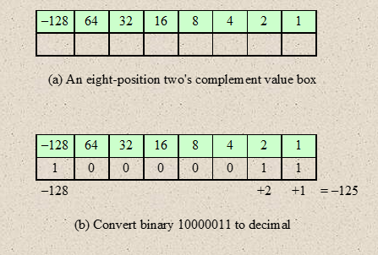
Example 1
-125 = 10000011 (twos complement)
1’s complement = 01111100
+ 1
2’s complement 01111101
Now convert it into decimal
01111101 = (0*-128) + (1*64) + (1*32) + (1*16) + (1*8) + (1*4) + (0*2) + (1*1) = 125
Notes:
A useful illustration of the nature of twos complement representation is a
value box, in which the value on the far right in the box is 1 (2⁰ ) and each succeeding
position to the left is double in value, until the leftmost position, which is negated.
As you can see in Figure 10.2a, the most negative twos complement number that
can be represented is - 2^{n-1} ; if any of the bits other than the sign bit is one, it adds a
positive amount to the number. Also, it is clear that a negative number must have a
1 at its leftmost position and a positive number must have a 0 in that position. Thus,
the largest positive number is a 0 followed by all 1s, which equals 2^{n-1} - 1.
The rest of Figure 10.2 illustrates the use of the value box to convert from twos
complement to decimal and from decimal to twos complement.

Slide 13
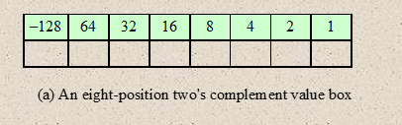
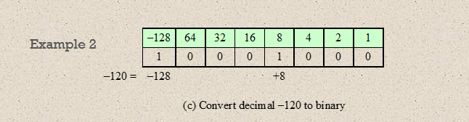
-120 = 10001000 (twos complement)
1’s complement = 01110111
+ 1
2’s complement 01111000
Now convert it into decimal
01111000 = (0*-128) + (1*64) + (1*32) + (1*16) + (1*8) + (0*4) + (0*2) + (0*1) = 120
Notes:
A useful illustration of the nature of twos complement representation is a
value box, in which the value on the far right in the box is 1 (2⁰ ) and each succeeding
position to the left is double in value, until the leftmost position, which is negated.
As you can see in Figure 10.2a, the most negative twos complement number that
can be represented is - 2^{n-1} ; if any of the bits other than the sign bit is one, it adds a
positive amount to the number. Also, it is clear that a negative number must have a
1 at its leftmost position and a positive number must have a 0 in that position. Thus,
the largest positive number is a 0 followed by all 1s, which equals 2^{n-1} - 1.
The rest of Figure 10.2 illustrates the use of the value box to convert from twos
complement to decimal and from decimal to twos complement.

Slide 14
Integer Arithmetic: Negation
Twos complement operation
Take the Boolean complement of each bit of the integer (including the sign bit)
Treating the result as an unsigned binary integer, add 1
The negative of the negative of that number is itself:
+18 = 00010010 (twos complement)
bitwise complement = 11101101
+ 1
11101110 = -18
-18 = 11101110 (twos complement)
bitwise complement = 00010001
+ 1
00010010 = +18
Notes:
In sign-magnitude representation, the rule for forming the negation of an integer is
simple: invert the sign bit. In twos complement notation, the negation of an integer
can be formed with the following rules:
1. Take the Boolean complement of each bit of the integer (including the sign
bit). That is, set each 1 to 0 and each 0 to 1.
2. Treating the result as an unsigned binary integer, add 1.
This two-step process is referred to as the twos complement operation, or the taking
of the twos complement of an integer.
As expected, the negative of the negative of that number is itself:

Slide 15
Negation Special Case 1
0 = 00000000 (twos complement)
Bitwise complement = 11111111
Add 1 to LSB + 1
Result 100000000
Overflow is ignored, so:
- 0 = 0
Notes:
There is a carry out of the most significant bit position, which is ignored. The result
is that the negation of 0 is 0, as it should be.

Slide 16
Negation Special Case 2
-128 = 10000000 (twos complement)
Bitwise complement = 01111111
Add 1 to LSB + 1
Result 10000000
So:
-(-128) = -128 X
Monitor MSB (sign bit)
It should change during negation
Notes:
The second special case is more of a problem. If we take the negation of the bit
pattern of 1 followed by n - 1 zeros, we get back the same number.

Slide 17
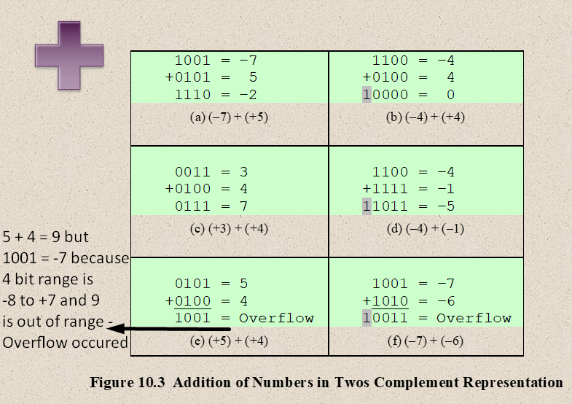
Notes:
Addition in twos complement is illustrated in Figure 10.3. Addition proceeds as if
the two numbers were unsigned integers. The first four examples illustrate successful
operations. If the result of the operation is positive, we get a positive number
in twos complement form, which is the same as in unsigned-integer form. If the
result of the operation is negative, we get a negative number in twos complement
form. Note that, in some instances, there is a carry bit beyond the end of the word
(indicated by shading), which is ignored.

Slide 18
OVERFLOW RULE:
If two numbers are added, and they are both positive or both negative, then overflow occurs if and only if the result has the opposite sign.
Ex: 8-bit max positive = +127/ -128
100+50=150, but 150 cannot fit in
8-bit, Overflow occurred!
Overflow
Rule
Notes:
On any addition, the result may be larger than can be held in the word size
being used. This condition is called overflow. When overflow occurs, the ALU must
signal this fact so that no attempt is made to use the result.
Figures 10.3e and f show examples of overflow. Note that overflow can occur
whether or not there is a carry.

Slide 19
Subtraction
SUBTRACTION RULE:
To subtract one number (subtrahend) from another (minuend), take the twos complement (negation) of the subtrahend and add it
to the minuend.
Rule
Notes:
Subtraction rule.

Slide 20
Notes:
Thus, subtraction is achieved using addition, as illustrated in Figure 10.4. The
last two examples demonstrate that the overflow rule still applies.

Slide 21
Notes:
Some insight into twos complement addition and subtraction can be gained by
looking at a geometric depiction [BENH92], as shown in Figure 10.5. The circle in
the upper half of each part of the figure is formed by selecting the appropriate segment
of the number line and joining the endpoints. Note that when the numbers are
laid out on a circle, the twos complement of any number is horizontally opposite that
number (indicated by dashed horizontal lines). Starting at any number on the circle,
we can add positive k (or subtract negative k) to that number by moving k positions
clockwise, and we can subtract positive k (or add negative k) from that number by
moving k positions counterclockwise. If an arithmetic operation results in traversal
of the point where the endpoints are joined, an incorrect answer is given (overflow).

Slide 22
Notes:
Figure 10.6 suggests the data paths and hardware elements needed to accomplish
addition and subtraction. The central element is a binary adder, which is presented
two numbers for addition and produces a sum and an overflow indication.
The binary adder treats the two numbers as unsigned integers. (A logic implementation
of an adder is given in Chapter 11.) For addition, the two numbers are
presented to the adder from two registers, designated in this case as A and B registers.
The result may be stored in one of these registers or in a third. The overflow
indication is stored in a 1-bit overflow flag (0 = no overflow; 1 = overflow). For
subtraction, the subtrahend (B register) is passed through a twos complementer
so that its twos complement is presented to the adder. Note that Figure 10.6 only
shows the data paths. Control signals are needed to control whether or not the complementer
is used, depending on whether the operation is addition or subtraction.

Slide 23
Space : 2n
Notes:
Compared with addition and subtraction, multiplication is a complex operation,
whether performed in hardware or software. A wide variety of algorithms have been
used in various computers. The purpose of this subsection is to give the reader some
feel for the type of approach typically taken. We begin with the simpler problem of
multiplying two unsigned (nonnegative) integers, and then we look at one of the most
common techniques for multiplication of numbers in twos complement representation.
Figure 10.7 illustrates the multiplication of unsigned
binary integers, as might be carried out using paper and pencil. Several important
observations can be made:
1. Multiplication involves the generation of partial products, one for each digit in the
multiplier. These partial products are then summed to produce the final product.
2. The partial products are easily defined. When the multiplier bit is 0, the partial
product is 0. When the multiplier is 1, the partial product is the multiplicand.
3. The total product is produced by summing the partial products. For this operation,
each successive partial product is shifted one position to the left relative
to the preceding partial product.
4. The multiplication of two n-bit binary integers results in a product of up to 2n
bits in length (e.g., 11 * 11 = 1001).
Compared with the pencil-and-paper approach, there are several things we can
do to make computerized multiplication more efficient. First, we can perform a running
addition on the partial products rather than waiting until the end. This eliminates
the need for storage of all the partial products; fewer registers are needed. Second,
we can save some time on the generation of partial products. For each 1 on the multiplier,
an add and a shift operation are required; but for each 0, only a shift is required.

Slide 24
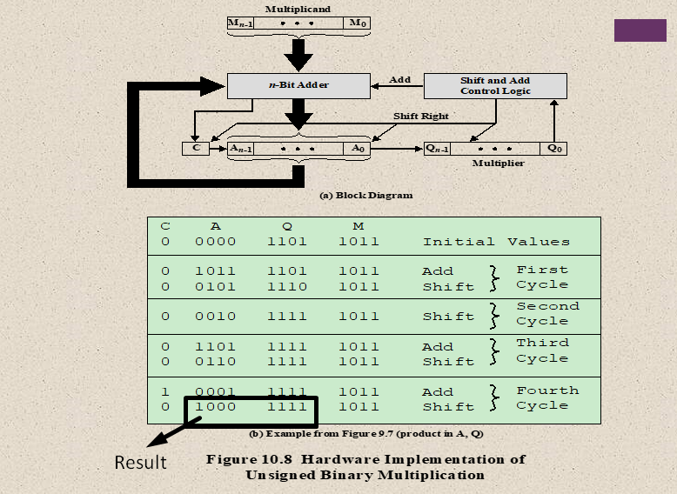
Notes:
Figure 10.8a shows a possible implementation employing these measures. The
multiplier and multiplicand are loaded into two registers (Q and M). A third register,
the A register, is also needed and is initially set to 0. There is also a 1-bit C register,
initialized to 0, which holds a potential carry bit resulting from addition.

Slide 25
Notes:
The operation of the multiplier is as follows. Control logic reads the bits of the
multiplier one at a time. If Q₀ is 1, then the multiplicand is added to the A register
and the result is stored in the A register, with the C bit used for overflow. Then all
of the bits of the C, A, and Q registers are shifted to the right one bit, so that the C
bit goes into A_{n-1}, A₀ goes into Q_{n-1} and Q₀ is lost. If Q₀ is 0, then no addition is
performed, just the shift. This process is repeated for each bit of the original multiplier.
The resulting 2n-bit product is contained in the A and Q registers. A flowchart
of the operation is shown in Figure 10.9, and an example is given in Figure 10.8b.
Note that on the second cycle, when the multiplier bit is 0, there is no add operation.

Slide 26
Space : 2n
Notes:
Figure 10.10 recasts Figure 10.7 to make the generation of partial products by multiplication explicit.
The only difference in Figure 10.10 is that it recognizes that the partial products
should be viewed as 2n-bit numbers generated from the n-bit multiplicand.
Thus, as an unsigned integer, the 4-bit multiplicand 1011 is stored in an 8-bit
word as 00001011. Each partial product (other than that for 2⁰ ) consists of this number
shifted to the left, with the unoccupied positions on the right filled with zeros
(e.g., a shift to the left of two places yields 00101100).

Slide 27
Multiplication in Binary
In digital systems, multiplication depends on whether numbers are unsigned or signed (2’s complement).
Unsigned Multiplication
All bits represent magnitude (no sign).
Perform normal binary multiplication (just like decimal).
Example: 5 × 3 = 101 × 011 = 1111 (15)
Signed Multiplication (2’s Complement)
MSB represents the sign:
0 → positive
1 → negative
We cannot directly multiply like unsigned because:
The MSB is not a normal value bit
It represents negative weight

Slide 28
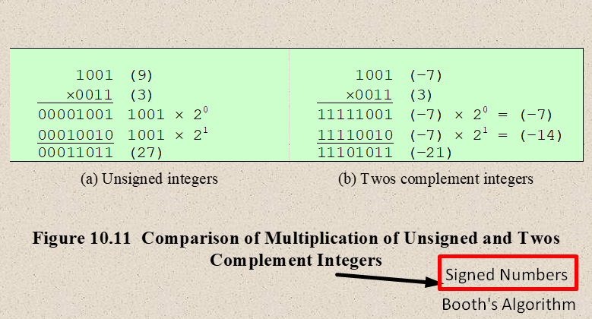
Notes:
Now we can demonstrate that straightforward multiplication will not work if
the multiplicand is negative. The problem is that each contribution of the negative
multiplicand as a partial product must be a negative number on a 2n-bit field; the sign
bits of the partial products must line up. This is demonstrated in Figure 10.11, which
shows that multiplication of 1001 by 0011. If these are treated as unsigned integers,
the multiplication of 9 * 3 = 27 proceeds simply. However, if 1001 is interpreted
as the twos complement value -7, then each partial product must be a negative
twos complement number of 2n (8) bits, as shown in Figure 10.11b. Note that this is
accomplished by padding out each partial product to the left with binary 1s.

Slide 29
Notes:
There are a number of ways out of this dilemma. One would be to convert
both multiplier and multiplicand to positive numbers, perform the multiplication,
and then take the twos complement of the result if and only if the sign of the two
original numbers differed. Implementers have preferred to use techniques that
do not require this final transformation step. One of the most common of these is
Booth’s algorithm [BOOT51]. This algorithm also has the benefit of speeding up
the multiplication process, relative to a more straightforward approach.
Booth’s algorithm is depicted in Figure 10.12 and can be described as follows.
As before, the multiplier and multiplicand are placed in the Q and M registers,
respectively. There is also a 1-bit register placed logically to the right of the least
significant bit (Q₀) of the Q register and designated Q₋₁ its use is explained shortly.
The results of the multiplication will appear in the A and Q registers. A and Q₋₁
are initialized to 0. As before, control logic scans the bits of the multiplier one at a
time. Now, as each bit is examined, the bit to its right is also examined. If the two
bits are the same (1–1 or 0–0), then all of the bits of the A, Q, and Q₋₁ registers are
shifted to the right 1 bit. If the two bits differ, then the multiplicand is added to or
subtracted from the A register, depending on whether the two bits are 0–1 or 1–0.
Following the addition or subtraction, the right shift occurs. In either case, the right
shift is such that the leftmost bit of A, namely, A_{n-1} not only is shifted into A_{n-2},
but also remains in A_{n-1}. This is required to preserve the sign of the number in A
and Q. It is known as an arithmetic shift, because it preserves the sign bit.

Slide 30
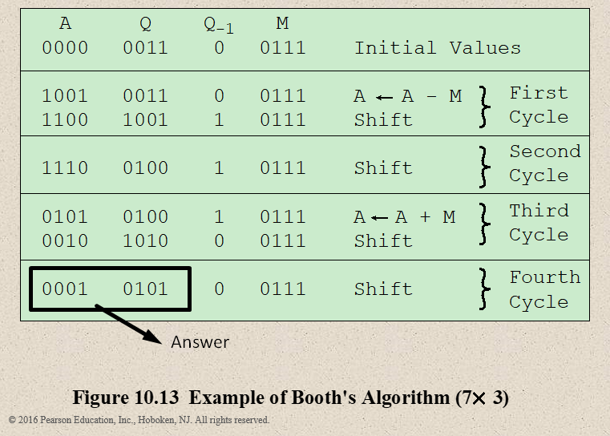
Notes:
Figure 10.13 shows the sequence of events in Booth’s algorithm for the multiplication
of 7 by 3.

Slide 31
Notes:
More compactly, the same operation is depicted in Figure 10.14a.
The rest of Figure 10.14 gives other examples of the algorithm. As can be seen, it
works with any combination of positive and negative numbers. Note also the efficiency
of the algorithm. Blocks of 1s or 0s are skipped over, with an average of only
one addition or subtraction per block.

Slide 32
Notes:
Division is somewhat more complex than multiplication but is based on the same
general principles. As before, the basis for the algorithm is the paper-and-pencil
approach, and the operation involves repetitive shifting and addition or subtraction.
Figure 10.15 shows an example of the long division of unsigned binary integers.
It is instructive to describe the process in detail. First, the bits of the dividend
are examined from left to right, until the set of bits examined represents a number
greater than or equal to the divisor; this is referred to as the divisor being able to
divide the number. Until this event occurs, 0s are placed in the quotient from left
to right. When the event occurs, a 1 is placed in the quotient and the divisor is subtracted
from the partial dividend. The result is referred to as a partial remainder.
From this point on, the division follows a cyclic pattern. At each cycle, additional
bits from the dividend are appended to the partial remainder until the result is
greater than or equal to the divisor. As before, the divisor is subtracted from this
number to produce a new partial remainder. The process continues until all the bits
of the dividend are exhausted.

Slide 33
Notes:
Figure 10.16 shows a machine algorithm that corresponds to the long division
process. The divisor is placed in the M register, the dividend in the Q register. At
each step, the A and Q registers together are shifted to the left 1 bit. M is subtracted
from A to determine whether A divides the partial remainder.3 If it does, then Q0
gets a 1bit. Otherwise, Q0 gets a 0 bit and M must be added back to A to restore the
previous value. The count is then decremented, and the process continues for n steps.
At the end, the quotient is in the Q register and the remainder is in the A register.

Slide 34
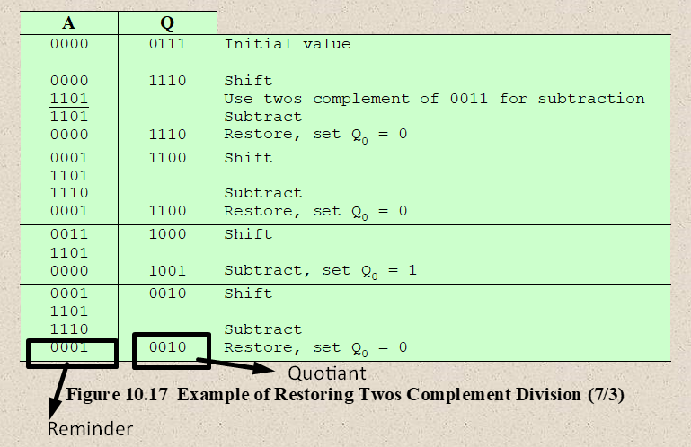
Q = 0111 (7), M = 0011 (3)
Notes:
This process can, with some difficulty, be extended to negative numbers. We
give here one approach for twos complement numbers. An example of this approach
is shown in Figure 10.17.
The reader will note from Figure 10.17 that ( - 7)/(3) and (7)/( - 3) produce
different remainders. We see that the magnitudes of Q and R are unaffected by the
input signs and that the signs of Q and R are easily derivable from the signs of D and
V. Specifically, sign(R ) = sign(D ) and sign(Q ) = sign(D ) * sign(V ). Hence, one
way to do twos complement division is to convert the operands into unsigned values
and, at the end, to account for the signs by complementation where needed. This is
the method of choice for the restoring division algorithm [PARH10].

Slide 35
Floating-Point Representation
Principles
With a fixed-point notation it is possible to represent a range of positive and negative integers centered on or near 0
By assuming a fixed binary or radix point, this format allows the representation of numbers with a fractional component as well
Limitations:
Very large numbers cannot be represented nor can very small fractions
The fractional part of the quotient in a division of two large numbers could be lost
Notes:
With a fixed-point notation (e.g., twos complement) it is possible to represent a
range of positive and negative integers centered on or near 0. By assuming a fixed
binary or radix point, this format allows the representation of numbers with a fractional
component as well.
This approach has limitations. Very large numbers cannot be represented, nor
can very small fractions. Furthermore, the fractional part of the quotient in a division
of two large numbers could be lost.
For decimal numbers, we get around this limitation by using scientific
notation. Thus, 976,000,000,000,000 can be represented as 9.76 * 10¹⁴ , and
0.0000000000000976 can be represented as 9.76 * 10-¹⁴ , What we have done, in
effect, is dynamically to slide the decimal point to a convenient location and use the
exponent of 10 to keep track of that decimal point. This allows a range of very large
and very small numbers to be represented with only a few digits.
This same approach can be taken with binary numbers.

Slide 36
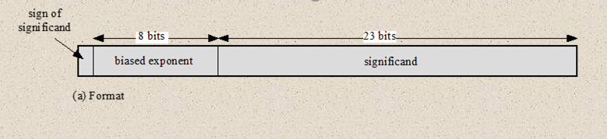

Notes:
The principles used in representing binary floating-point numbers are best
explained with an example. Figure 10.18a shows a typical 32-bit floating-point format.
The leftmost bit stores the sign of the number (0 = positive, 1 = negative).
The exponent value is stored in the next 8 bits. The representation used is known as
a biased representation. A fixed value, called the bias, is subtracted from the field
to get the true exponent value. Typically, the bias equals (2^{k-1} - 1), where k is the
number of bits in the binary exponent. In this case, the 8-bit field yields the numbers
0 through 255. With a bias of 127 (2⁷ - 1), the true exponent values are in the range
-127 to +128. In this example, the base is assumed to be 2.

Slide 37
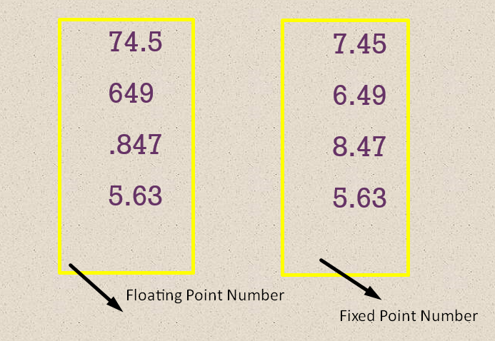
74.5
649
.847
5.63
7.45
6.49
8.47
5.63
The decimal point “floats” (can move).
The decimal (binary) point is fixed at a specific position.

Slide 38
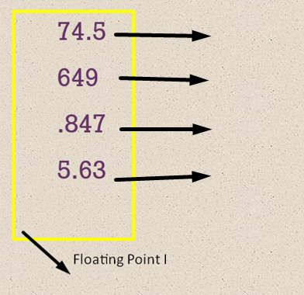
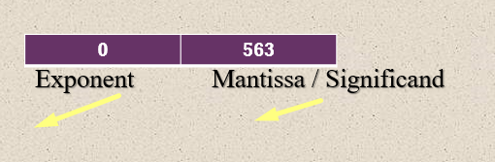
Normalization
7.45 * 10 ¹
6.49 * 10 ²
8.47 * 10 ⁻¹
5.63 * 10 ⁰
The exponent determines how far the binary point moves, while the mantissa (significand) represents the actual digits of the number

Slide 39
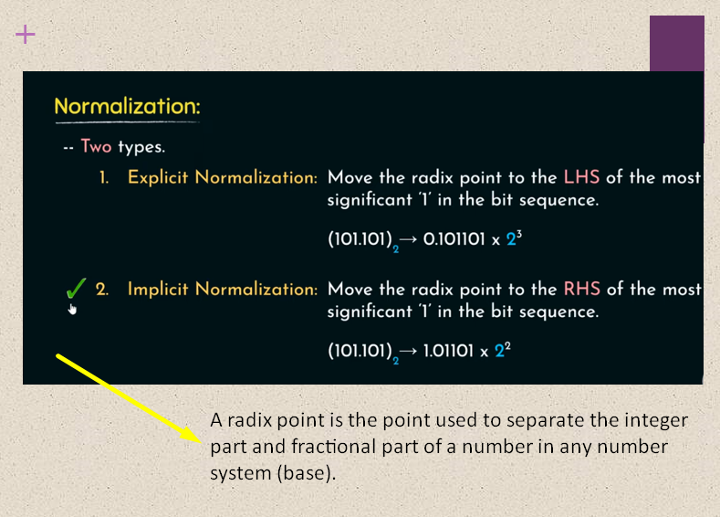

Slide 40
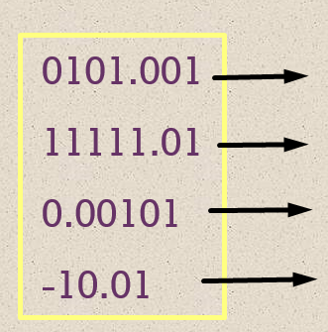
1.01001 * 2 ²
1.111101 * 2 ⁴
1.01 * 2 ⁻²
- 1.001 * 2 ¹
1 | 1 | 001
Sign Exponent Mantissa
Explicit Normalization = (-1) ^{s} * 0.M * 2 ^{E}
Implicit Normalization = (-1) ^{s} * 1.M * 2 ^{E}

Slide 41
Explicit Normalization = (-1) ^{s} * 0.M * 2 ^{E}
Implicit Normalization = (-1) ^{s} * 1.M * 2 ^{E}
Ex: 101.1 – let’s normalize it
Left Shift: 0.1011 * 2 ³
Ex: .00110 – let’s normalize it
Right Shift: 00.110 * 2 ⁻²
Solution After Biasing :
1 | 00 11 | 1011 0
Sign (1) Exponent (4) Mantissa (5)
0 | Biasing??? | 110 00
Sign (1) Exponent (4) Mantissa (5)
0 | 0110 (6) | 110 00

Slide 42
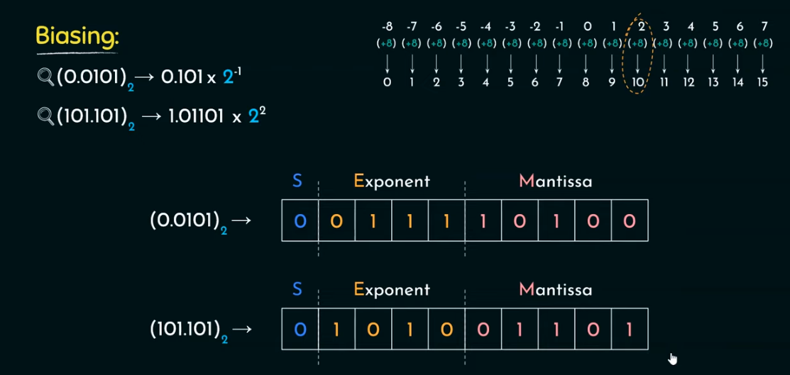
Range Formula: -2 ^{n-1} 2 ^{n-1} -1
-2 ⁴⁻¹ 2 ⁴⁻¹ -1 = - 8 to 7
Explicit Normalization = (-1) ^{s} * 0.M * 2 ^{E - Bias}
Implicit Normalization = (-1) ^{s} * 1.M * 2 ^{E - Bias}

Slide 43
Floating-Point
Significand
The final portion of the word
Any floating-point number can be expressed in many ways
Normal number
The most significant digit of the significand is nonzero
The following are equivalent, where the significand is expressed in binary form:
0.110 * 2⁵
110 * 2²
0.0110 * 2⁶
Notes:
Table 10.2 shows the biased representation for 4-bit integers. Note that when
the bits of a biased representation are treated as unsigned integers, the relative magnitudes
of the numbers do not change. For example, in both biased and unsigned
representations, the largest number is 1111 and the smallest number is 0000. This is
not true of sign-magnitude or twos complement representation. An advantage of
biased representation is that nonnegative floating-point numbers can be treated as
integers for comparison purposes.
The final portion of the word (23 bits in this case) is the significand.
Any floating-point number can be expressed in many ways.
To simplify operations on floating-point numbers, it is typically required that they
be normalized. A normal number is one in which the most significant digit of the
significand is nonzero. For base 2 representation, a normal number is therefore one
in which the most significant bit of the significand is one.

Slide 44
Notes:
Figure 10.19 indicates the range of numbers that can be represented
in a 32-bit word. Using twos complement integer representation, all of the
integers from -2³¹ to 2³¹ - 1 can be represented, for a total of 2³² different numbers.
With the example floating-point format of Figure 10.18, the following ranges
of numbers are possible:
• Negative numbers between -(2 - 2⁻²³) * 2¹²⁸ and -2⁻¹²⁷
• Positive numbers between 2⁻¹²⁷ and (2 - 2⁻²³) * 2¹²⁸
Five regions on the number line are not included in these ranges:
• Negative numbers less than -(2 - 2⁻²³) * 2¹²⁸, called negative overflow
• Negative numbers greater than 2⁻¹²⁷, called negative underflow
• Zero
• Positive numbers less than 2⁻¹²⁷, called positive underflow
• Positive numbers greater than (2 - 2⁻²³) * 2¹²⁸, called positive overflow
The representation as presented will not accommodate a value of 0.
However, as we shall see, actual floating-point representations include a special
bit pattern to designate zero. Overflow occurs when an arithmetic operation
results in an absolute value greater than can be expressed with an exponent of 128
(e.g., 2¹²⁰ * 2¹⁰⁰ = 2²²⁰). Underflow occurs when the fractional magnitude is too
small (e.g., 2⁻¹²⁰ * 2⁻¹⁰⁰ = 2⁻²²⁰). Underflow is a less serious problem because
the result can generally be satisfactorily approximated by 0.
It is important to note that we are not representing more individual values
with floating-point notation. The maximum number of different values that can be
represented with 32 bits is still 2³². What we have done is to spread those numbers
out in two ranges, one positive and one negative. In practice, most floating-point
numbers that one would wish to represent are represented only approximately.
However, for moderate sized integers, the representation is exact.

Slide 45
Questions for practice
Convert the following numbers into normalized form?
5₁₀
0.25 ₁₀
10.25 ₁₀
- 4.5 ₁₀
101.101 – Explicit & Implicit
Given Format:
Sign = 1 bit
Exponent = 3 bits (bias = 3)
Mantissa = 4 bits
101.1
0.011
110.01
S | E (4 bits) | M (5 bit)

Slide 46
IEEE Standard 754
Most important floating-point representation is defined
Standard was developed to facilitate the portability of programs from one processor to another and to encourage the development of sophisticated, numerically oriented programs
Standard has been widely adopted and is used on virtually all contemporary processors and arithmetic coprocessors
IEEE 754-2008 covers both binary and decimal floating-point representations
Notes:
The most important floating-point representation is defined in IEEE Standard 754,
adopted in 1985 and revised in 2008. This standard was developed to facilitate the
portability of programs from one processor to another and to encourage the development
of sophisticated, numerically oriented programs. The standard has been
widely adopted and is used on virtually all contemporary processors and arithmetic
coprocessors. IEEE 754-2008 covers both binary and decimal floating-point representations.
In this chapter, we deal only with binary representations.

Slide 47
IEEE 754-2008
Defines the following different types of floating-point formats:
Arithmetic format
All the mandatory operations defined by the standard are supported by the format. The format may be used to represent floating-point operands or results for the operations described in the standard.
Basic format
This format covers five floating-point representations, three binary and two decimal:
Binary: 32 bit (Single Precision), 64 bit (double), 128 bit Quad)
Decimal: 64 bit, and 128 bit
Interchange format
A fully specified, fixed-length binary encoding that allows data interchange between different platforms and that can be used for storage.
Notes:
IEEE 754-2008 defines the following different types of floating-point formats:
• Arithmetic format: All the mandatory operations defined by the standard are
supported by the format. The format may be used to represent floating-point
operands or results for the operations described in the standard.
• Basic format: This format covers five floating-point representations, three
binary and two decimal, whose encodings are specified by the standard, and
which can be used for arithmetic. At least one of the basic formats is implemented
in any conforming implementation.
• Interchange format: A fully specified, fixed-length binary encoding that allows
data interchange between different platforms and that can be used for storage.

Slide 48
A biased exponent is a way of storing the exponent in floating-point numbers by adding a fixed value (bias) to it so that we can represent both positive and negative exponents using only unsigned binary numbers.
Stored Exponent=Actual Exponent + Bias
Notes:
The three basic binary formats have bit lengths of 32, 64, and 128 bits, with
exponents of 8, 11, and 15 bits, respectively (Figure 10.21).

Slide 49
Precision Considerations
Rounding
IEEE standard approaches:
Round to nearest:
The result is rounded to the nearest representable number. Ex: Value: 2.6 → 3 , Value: 2.4 → 2 Value: 2.5 → 2 (even)
Round toward +∞ :
The result is rounded up toward plus infinity. Ex: 2.3 → 3 and -2.3 → -2
Round toward -∞:
The result is rounded down toward negative infinity. Ex: 2.7 → 2 and -2.3 → -3
Round toward 0:
The result is rounded toward zero, drop fractional part. Ex: 2.9 → 2 and -2.9 → -2
Notes:
Another detail that affects the precision of the result is the rounding
policy. The result of any operation on the significands is generally stored in a longer
register. When the result is put back into the floating-point format, the extra bits
must be eliminated in such a way as to produce a result that is close to the exact
result. This process is called rounding.
A number of techniques have been explored for performing rounding. In fact,
the IEEE standard lists four alternative approaches:
• Round to nearest: The result is rounded to the nearest representable number.
• Round toward +∞ : The result is rounded up toward plus infinity.
• Round toward -∞: The result is rounded down toward negative infinity.
• Round toward 0: The result is rounded toward zero.
Let us consider each of these policies in turn. Round to nearest is the default
rounding mode listed in the standard and is defined as follows: The representable
value nearest to the infinitely precise result shall be delivered.
The standard also addresses the special case of extra bits of the form 10000.…
Here the result is exactly halfway between the two possible representable values.
One possible technique here would be to always truncate, as this would be the simplest
operation. However, the difficulty with this simple approach is that it introduces
a small but cumulative bias into a sequence of computations. What is required
is an unbiased method of rounding. One possible approach would be to round up or
down on the basis of a random number so that, on average, the result would be unbiased.
The argument against this approach is that it does not produce predictable,
deterministic results. The approach taken by the IEEE standard is to force the result
to be even: If the result of a computation is exactly midway between two representable
numbers, the value is rounded up if the last representable bit is currently 1 and
not rounded up if it is currently 0.

Slide 50
Summary
Computer
Arithmetic
Chapter 10
Integer arithmetic
Negation
Addition and subtraction
Multiplication
Division
Floating-point arithmetic
Addition and subtraction
Multiplication and division
Precision consideration
IEEE standard for binary floating-point arithmetic
ALU
Integer representation
Sign-magnitude representation
Twos complement representation
Range extension
Fixed-point representation
Floating-point representation
Principles
IEEE standard for binary floating-point representation
Notes:
Chapter 10 summary.

